Slide 1

IBM University Engagement
Project Submission
"Exploring the Power of Machine Learning with IBM Cloud"
Project Title –
Intelligent Classification of Rural Road Infrastructure Projects under PMGSY using Machine Learning
Domain of Project –
Government / Rural Infrastructure
Student Name
Recent Passport
Photo
Email ID
Mobile number
[WhatsApp]
Ahad Gour
ahadgour0211@gmail.com
9588435658

Slide 2
Problem Statement: Intelligent Classification of Rural Road Infrastructure Projects under PMGSY using Machine Learning
The Pradhan Mantri Gram Sadak Yojana (PMGSY) is a flagship rural development program by the Government of India, launched to provide all-weather road connectivity to eligible unconnected habitations. The program has evolved through different phases or schemes — PMGSY-I, PMGSY-II, and RCPLWEA — each with distinct objectives, funding mechanisms, and project specifications.
For government bodies, infrastructure planners, and policy analysts, efficiently categorizing thousands of ongoing and completed road and bridge construction projects is crucial for effective monitoring, transparent budget allocation, and assessing the long-term impact of these schemes. Manual classification is time-consuming, prone to errors, and scales poorly.
Your specific task is to design, build, and evaluate a machine learning model that can automatically classify a road or bridge construction project into its correct PMGSY_SCHEME based on its physical and financial characteristics such as state, district, number of road works sanctioned, length of road work sanctioned, and number of bridges sanctioned.

Slide 3
Proposed Solution – Technology Used
• IBM Cloud: It provides the infrastructure to build, deploy, and scale the PMGSY Classification System efficiently. IBM Cloud enables a reliable, secure, and scalable environment for deploying the model.
• ML Algorithm / Model Used: Batched Tree Ensemble Classifier (XGB Classifier) selected as Pipeline 10, the top-ranked model by AutoAI on the pipeline leaderboard.
•
Accuracy Obtained: 92.4% (0.924) optimized accuracy with matching cross-validation score.
• Enhancements and Hyperparameter Tuning: HPO-1 (Hyperparameter Optimization Round 1), FE (Feature Engineering), HPO-2 (Hyperparameter Optimization Round 2), BATCH (Ensemble/Batch creation).
• IBM Watson Studio (AutoAI): Automatically handles data preprocessing, feature engineering, model selection, and hyperparameter tuning generating 10 candidate pipelines ranked by accuracy.
• IBM Cloud Object Storage: Stores the PMGSY dataset, trained model assets, and project files within the Watson Studio project workspace.

Slide 4
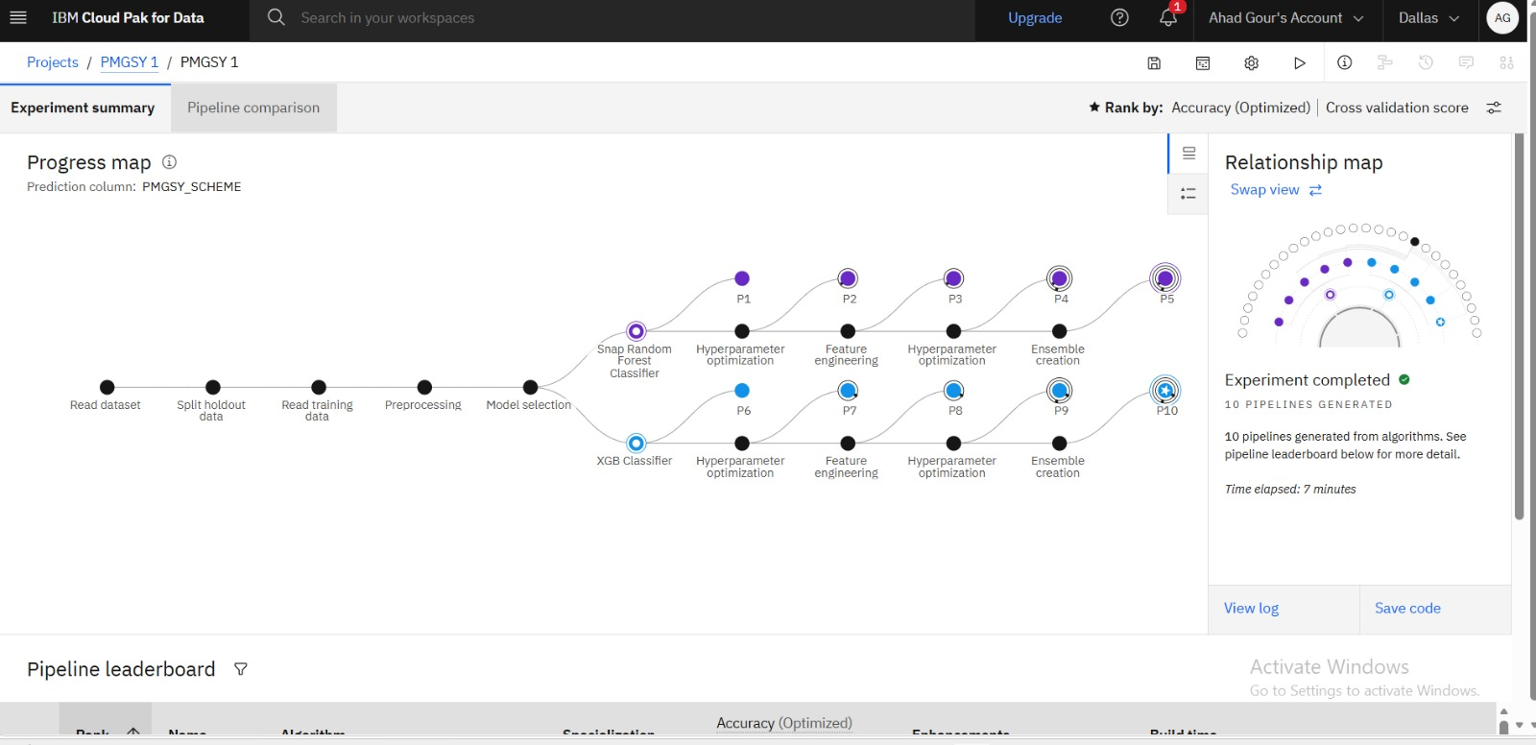
Training Screenshots–

Slide 5
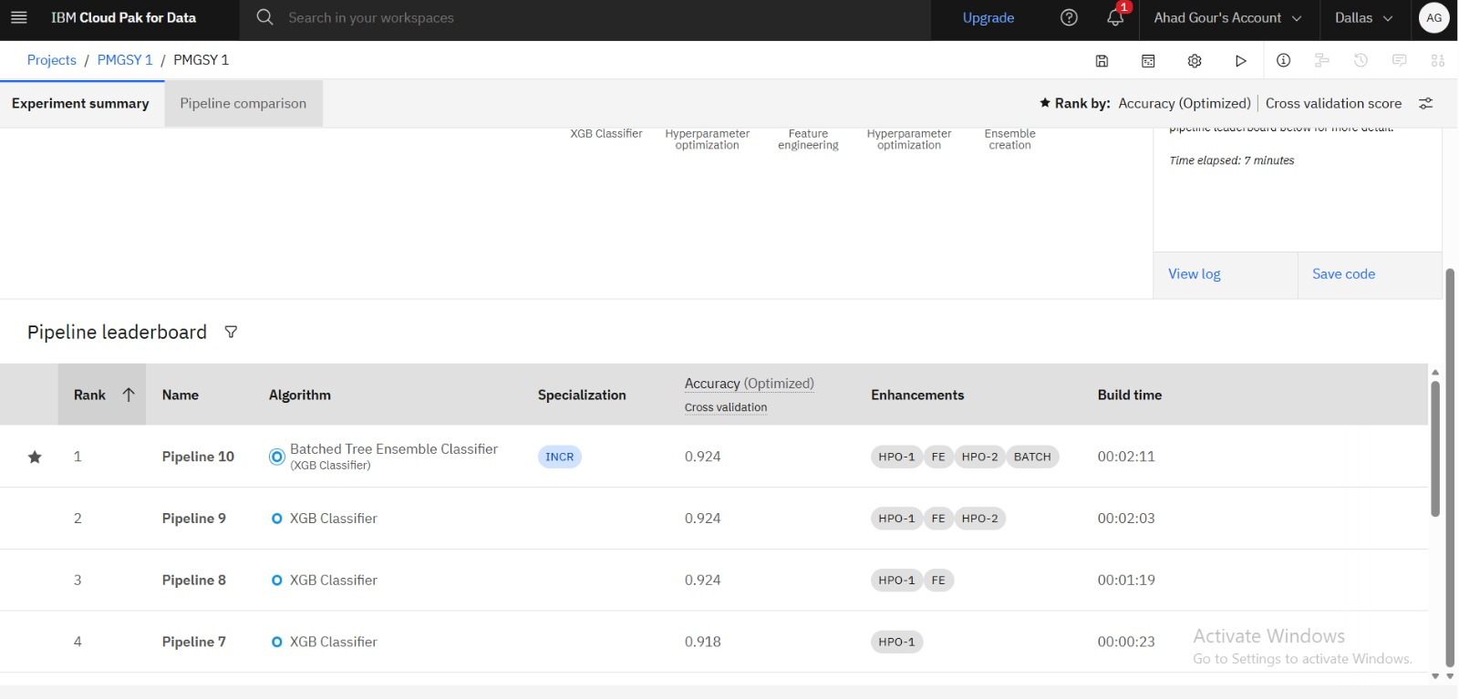
Best Model Screenshot:

Slide 6
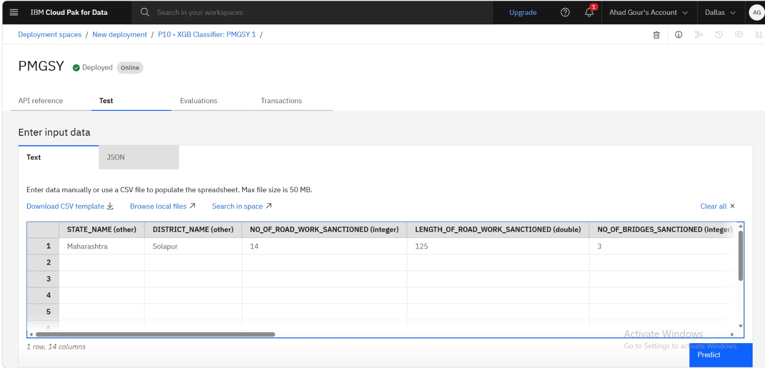
Testing Screenshot:

Slide 7
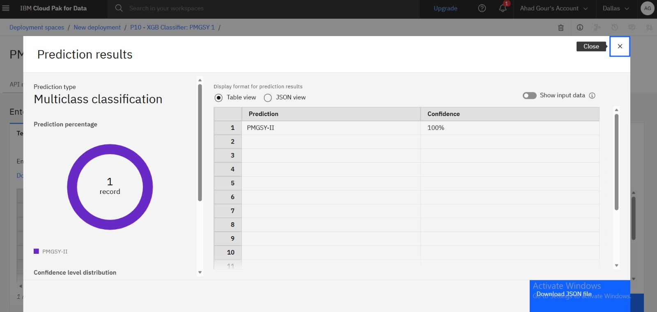
Testing Screenshot:

Slide 8
Novelty and Uniqueness
• The solution automates PMGSY scheme classification, eliminating manual, time-consuming, and error-prone categorization of road and bridge construction project records.
• It uses IBM watsonx.ai AutoAI to automatically discover the best machine learning model (XGB Classifier with 92.4% accuracy) without extensive hand-coding.
• The system classifies road and bridge projects into multiple PMGSY scheme categories (PMGSY-I, PMGSY-II, RCPLWEA) through a single intelligent platform.
• Automated feature engineering helps identify hidden patterns in physical and financial project data across states and districts.
• The model ensures consistent and unbiased scheme allocation, supporting transparent budget monitoring and reducing human errors in classification.
• Built end-to-end on IBM Cloud, the solution is scalable and can be integrated with government MIS dashboards for real-time project categorization.

Slide 9
Git Hub Link
Please create public github repository (Enable Add README button while creating repository)
Please test and Paste the working Github URL –
https://github.com/AhadGour/PMGSY-Scheme-Classification-ML
Make sure you have Uploaded following files into your github repository:
1) Data.csv file (PMGSY_DATASET.csv)
2) Problem Statement PDF (Problem_Statement_35_Rural_Infrastructure_Cl...)
3) Project Presentation .pptx file
4) Python Notebook downloaded from IBM Cloud (PMGSY 1.ipynb)

Slide 10
Future Scope
• The system can be integrated with PMGSY-OMMS government portals to automate the end-to-end scheme classification and monitoring process.
• Additional rural infrastructure programs and schemes can be included, enabling a unified AI-based project categorization platform.
• Real-time data integration with government MIS databases can improve classification accuracy and support fraud/anomaly detection for cost overruns.
• Advanced AI models in IBM watsonx.ai can be used to continuously improve prediction accuracy as new project data becomes available.
• The solution can be extended to predict project completion delays, supporting proactive planning and resource allocation.
• The model can be scaled nationwide to support faster, transparent, and data-driven infrastructure monitoring across all PMGSY phases.

Slide 11
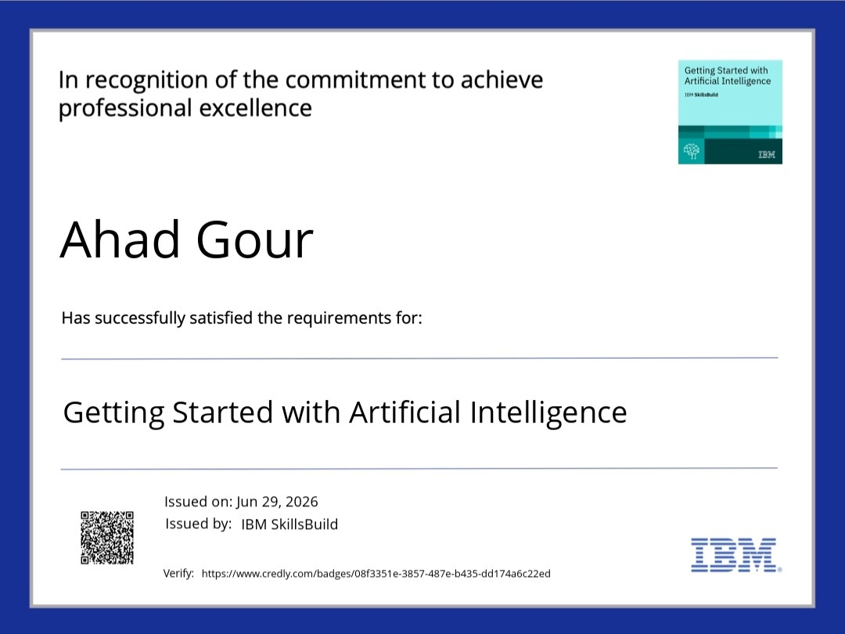
Certificates Earned: Getting Started With Artificial Intelligence
[Add your Credly certificate screenshot here]

Slide 12
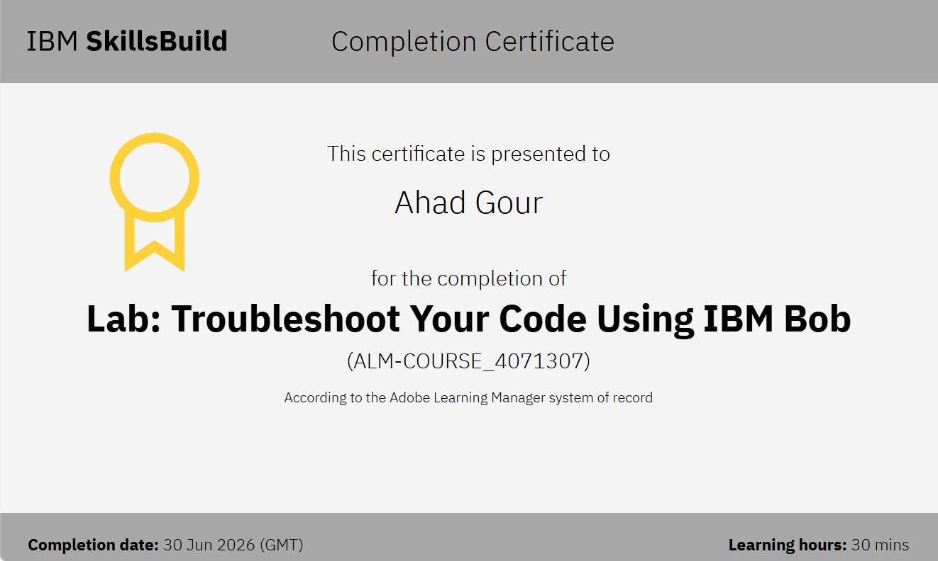
Certificates Earned:
Lab:Troubleshoot Your Code IBM BOB Certificate

Slide 13
Thank You!
Thank you for your time and interest.

